Slide 1


Formatter in Java

Slide 2
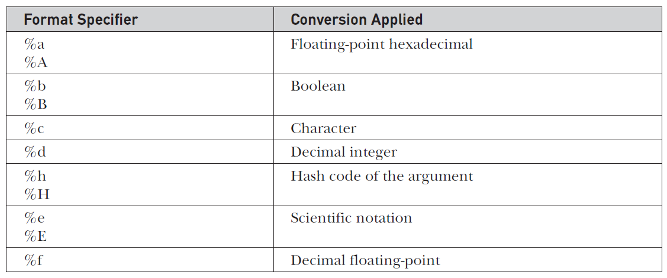

Slide 3
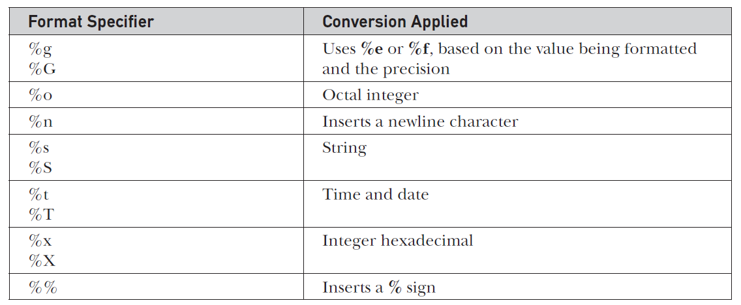

Slide 4
Suffix | Replaced By | Suffix | Replaced By
a | Abbreviated weekday name | L | Millisecond (000 to 999)
A | Full weekday name | m | Month as decimal (01 to 13)
B | Abbreviated month name | M | Minute as decimal (00 to 59)
B | Full month name | N | Nanosecond (000000000 to 999999999)
c | Standard date and time string formatted as day month date hh::mm:ss tzone year | p | Locale’s equivalent of AM or PM in lowercase
C | First two digits of year | Q | Milliseconds from 1/1/1970
d | Day of month as a decimal (01—31) | r | hh:mm:ss (12-hour format)
D | month/day/year | R | hh:mm (24-hour format)
e | Day of month as a decimal (1—31) | S | Seconds (00 to 60)
F | year-month-day | s | Seconds from 1/1/1970 UTC
h | Abbreviated month name | T | hh:mm:ss (24-hour format)
H | Hour (00 to 23) | y | Year in decimal without century (00 to 99)
I | Hour (01 to 12) | Y | Year in decimal including century (0001 to 9999)
j | Day of year as a decimal (001 to 366) | z | Offset from UTC
k | Hour (0 to 23) | Z | Time zone name
l | Hour (1 to 12) | Z | Time zone name

